Slide 1

2015 Flight Delays and Cancellations
Group 1 :
Pranjal Shukla
Eric Tien
Sai Chaithanya Vadakattu
Jinni Yang
Frank Yao

Slide 2
Summary and Expectation.
We wrangled data into dimensional model using CSVkit, xsv and SQL to answer three business questions.
For the data visualization part we have used SQL and Tableau Desktop
Expectation:
Airline performance vs cost.
What’s the best way to fly from D.C. to New York?
Customer Attitude on Social Media, Any values?

Slide 3
ASK 1
Data Descriptions -
Three CSV files – Airport, Airline and Flights
Size : 592.41 MB last updated : 2015
5800k Domestic flight trip completed.
Summary information on the number of on-time, delayed, cancelled, and diverted flights
Source: - The U.S. Department of Transportation's (DOT) Bureau of Transportation Statistics tracks the on-time performance of domestic flights operated by large air carriers
Additional Dataset- twitter Sentiment Analysis 2015.

Slide 4
ASK 2
Clean data set using CSVkit, SQL and XSC
Filter necessary attributes based on our business questions and drop those unrelated columns.
Replace the missing and mismatched values by null.
Upload and examine the final dataset by Unix command-line tools
In the flight data set initially we had 31 columns and we filtered and narrowed it down to 17 columns
We Create 4 dimensional table Airline, Airport, Date and Flight.

Slide 5
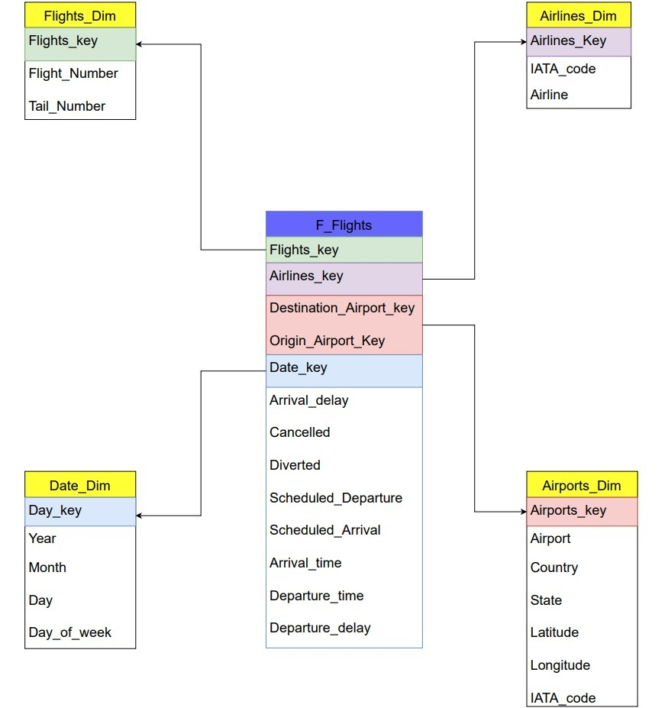
Dimensional Modeling

Slide 6
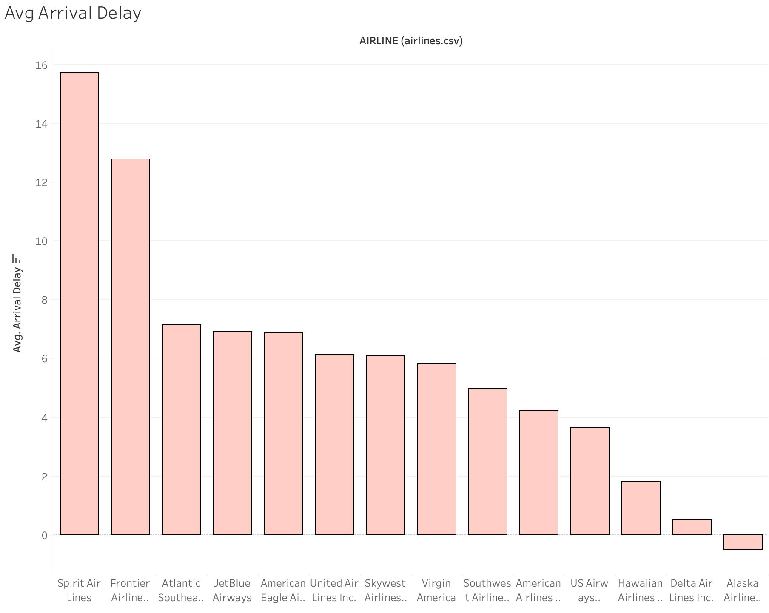
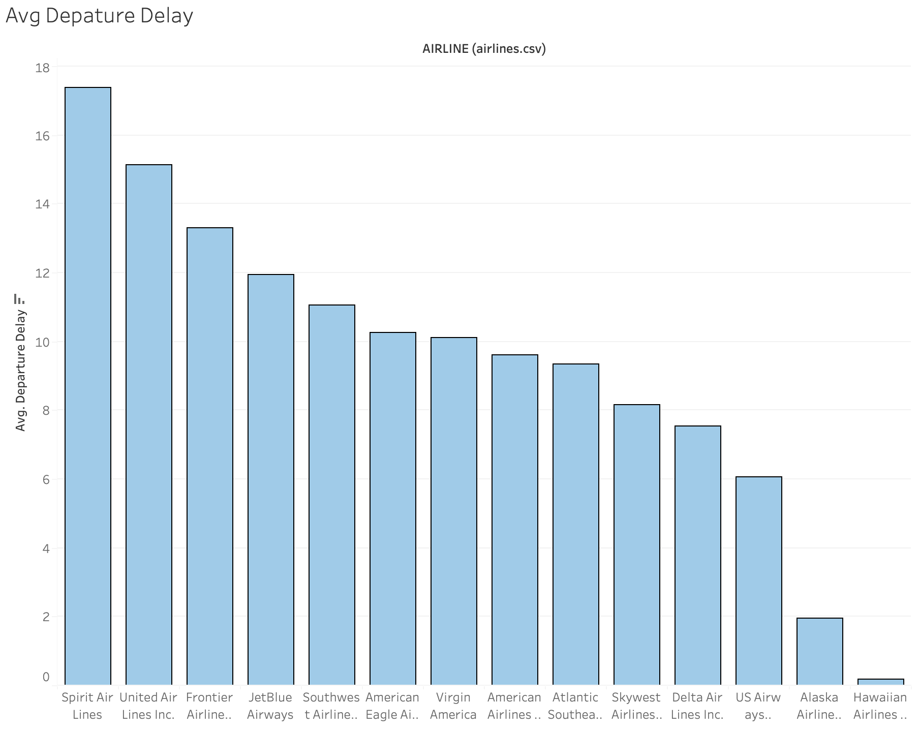
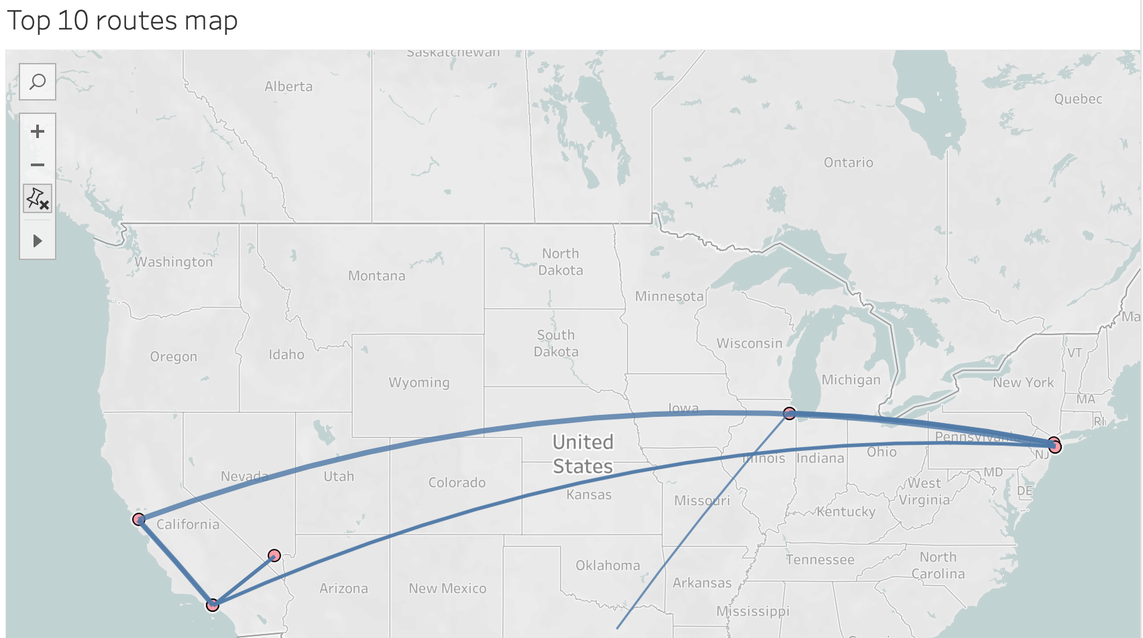
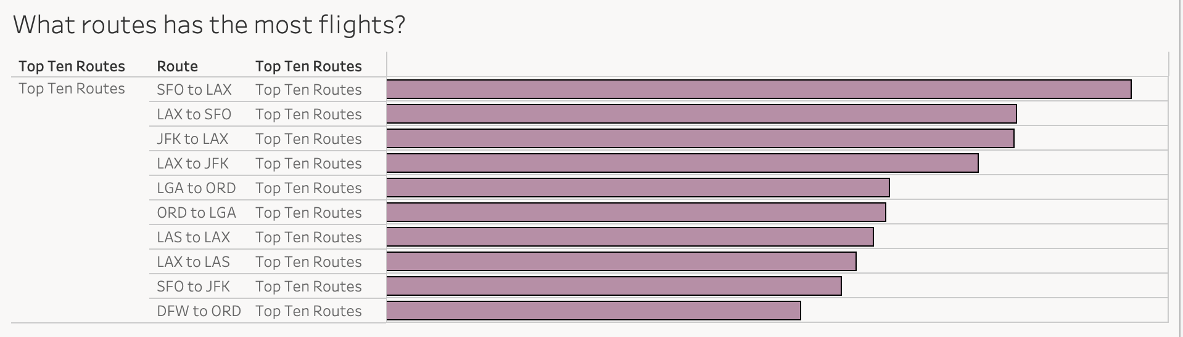
ASK 3
Q1 Analysis of Airlines’ performance

Slide 7
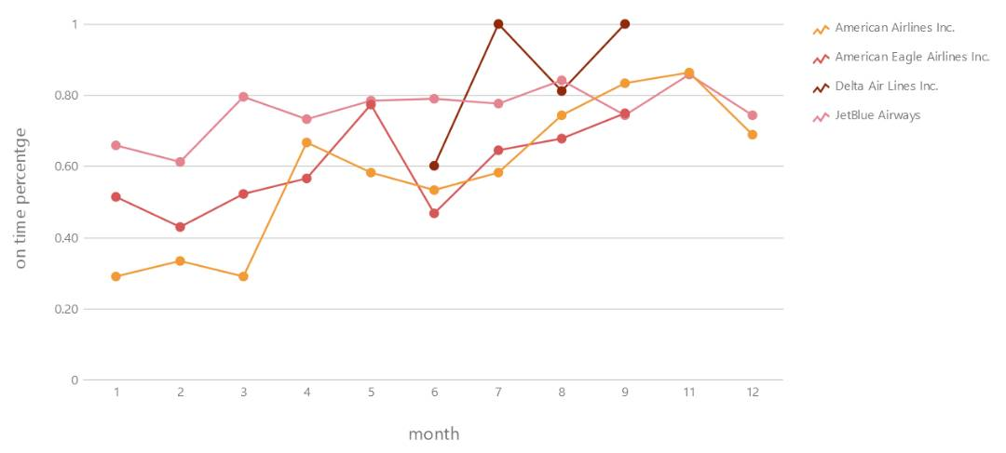
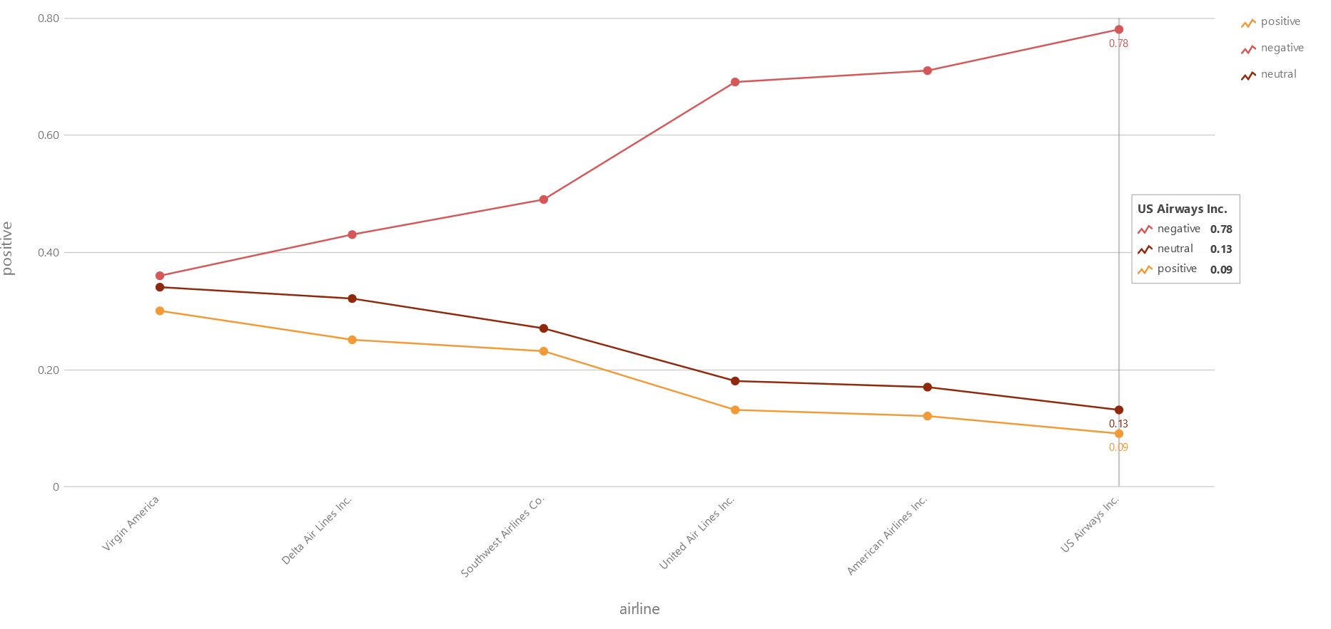
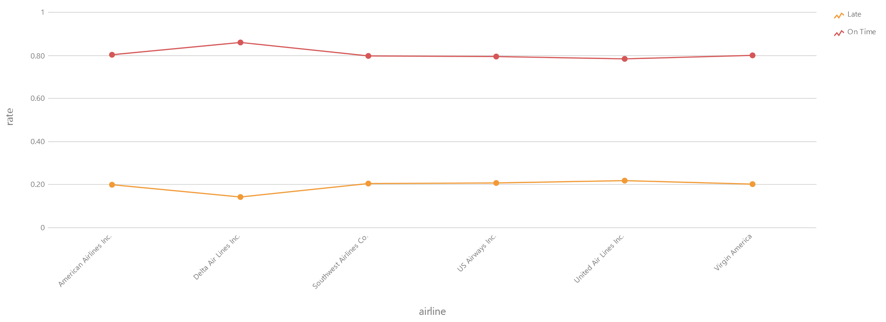
ASK 3
Q3 Analysis of the relationship between Airlines’ performance and customer's attitude in Twitter
Q2 Analysis of Airlines from DC to New York

